Slide 1

Security Information
By, Dr. Taghinezhad
Mail: a0taghinezhad@gmail.com

Slide 2

About This Course
Source:
Network Security Essentials from William Stallings

Slide 3
About This Course
Class
Project
Exam
Grading
2
4
14
20

Slide 4
Bachelor's Degree in Microbiology
Mercury
Mercury is small and the closest planet to the Sun

Slide 5
Bachelor's Degree in Microbiology
Step 01
Step 02
Step 03
Step 04
Mercury
Venus
Earth
Mars
Mercury is the closest planet to the Sun
Venus has a beautiful name and is very hot
Earth is the only planet that harbors life
Despite being red, Mars is a very cold place

Slide 6
Bachelor's Degree in Microbiology
10%
25%
Mercury
Venus
Mercury is the closest planet to the Sun
The Earth is the only planet that harbors life
50%
75%
Venus
Mars
Venus has a beautiful name and it’s terribly hot
Despite being red, Mars is actually a very cold place

Slide 7
Bachelor's Degree in Microbiology
25%
50%
75%
Mercury
Venus
Earth
Mercury is the closest planet to the Sun and the smallest one of them all
Venus has a beautiful name and it’s the second planet from the Sun
Earth is the third planet and the only one that harbors life

Slide 8
Bachelor's Degree in Microbiology
Mercury
Mars
Mercury is small and the closest planet to the Sun
Despite being red, Mars is actually a cold place
Venus
Jupiter
Venus is the second planet from the Sun
Jupiter is the biggest planet of them all
Earth
Saturn
Earth is the only planet that harbors life
Saturn is composed of hydrogen and helium

Slide 9
Bachelor's Degree in Microbiology
Mercury
Mercury is small and the closest planet to the Sun
5/5
Venus
Venus is the second planet from the Sun
3/5
Earth
Earth is the only planet that harbors life
2/5
Mars
Despite being red, Mars is actually a cold place
0/5

Slide 10
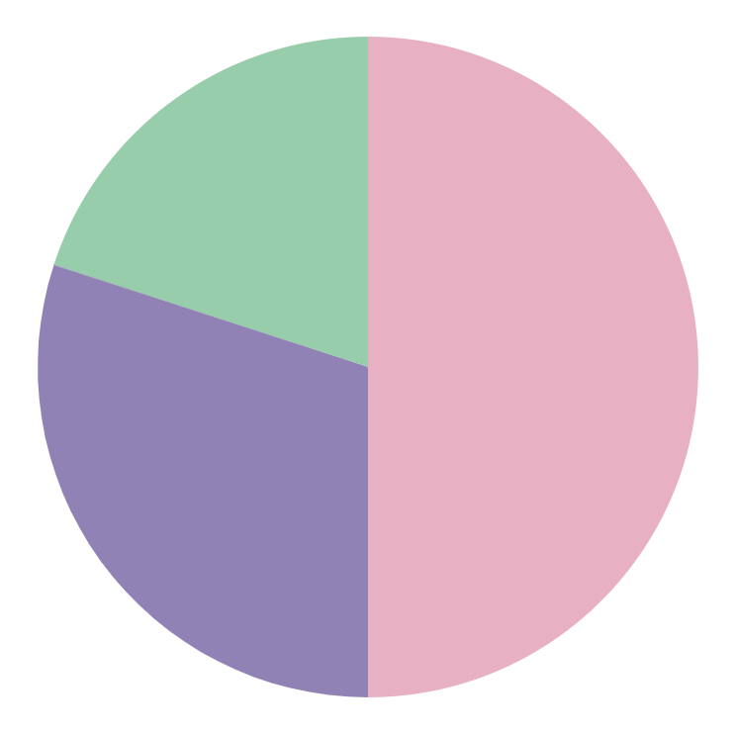
Bachelor's Degree in Microbiology
50% - Mercury
Mercury is the closest planet to the Sun and the smallest of them all
30% - Venus
Venus has a beautiful name and it’s the second planet from the Sun
20% - Earth
Earth is the third planet from the Sun and the only one that harbors life
Follow the link in the graph to modify its data and then paste the new one here. For more info, click here

Slide 11
Bachelor's Degree in Microbiology
Mercury
Mars
Mercury is the smallest planet of them all
Despite being red, Mars is a cold place
Venus
Sun
Jupiter
Venus is the second planet from the Sun
The Sun is the star at the center of the Solar System. Three quarters of the Sun is hydrogen
Jupiter is the biggest planet of them all
Earth
Saturn
Earth is the only planet that harbors life
Saturn is composed of hydrogen and helium

Slide 12
Bachelor's Degree in Microbiology
Mercury
Venus
Mercury is the closest planet to the Sun and the smallest one in the entire Solar System
Venus has a beautiful name and is the second planet from the Sun. It’s terribly hot
Earth
Mars
Earth is the third planet from the Sun and the only one that harbors life in the Solar System
Mars is a cold place. It’s full of iron oxide dust, which gives the planet its reddish cast

Slide 13
Bachelor's Degree in Microbiology
Sun
Mercury
Mars
Mercury is the closest planet to the Sun and the smallest of them all
Despite being red, Mars is actually a cold place. It is full of iron oxide dust
Venus
Earth
Jupiter
Saturn
Venus has a beautiful name
Earth is known as the Blue Planet
Jupiter is a very big planet
Saturn has several beautiful rings

Slide 14
Bachelor's Degree in Microbiology
Mercury
Mercury is the closest planet to the Sun and the smallest of them all
Venus
Venus has a beautiful name and is the second planet from the Sun
Earth
Earth is the third planet from the Sun and the only one that harbors life
Mars
Despite being red, Mars is a cold place. It is full of iron oxide dust

Slide 15
Bachelor's Degree in Microbiology
Mercury
01
04
Venus
Mercury is the closest planet to the Sun
Venus is the second planet from the Sun
Saturn
02
05
Earth
Saturn is composed of hydrogen and helium
Earth is the only planet that harbors life
Jupiter
03
06
Mars
Jupiter is the biggest planet of them all
Despite being red, Mars is actually a cold place

Slide 16
Bachelor's Degree in Microbiology
01
02
Mercury
Venus
Mercury is the closest planet to the Sun
Venus is the second planet of them all
Sun
The Sun is the star at the center of the Solar System. Three quarters of the Sun is hydrogen
03
04
Earth
Mars
Earth is the only planet that harbors life
Despite being red, Mars is actually a cold place

Slide 17
Bachelor's Degree in Microbiology
4/5
3/5
2/5
1/5
Mercury
Venus
Earth
Mars
Mercury is the closest planet to the Sun
Venus has a beautiful name and is very hot
Earth is the only planet that harbors life
Despite being red, Mars is a very cold place

Slide 18
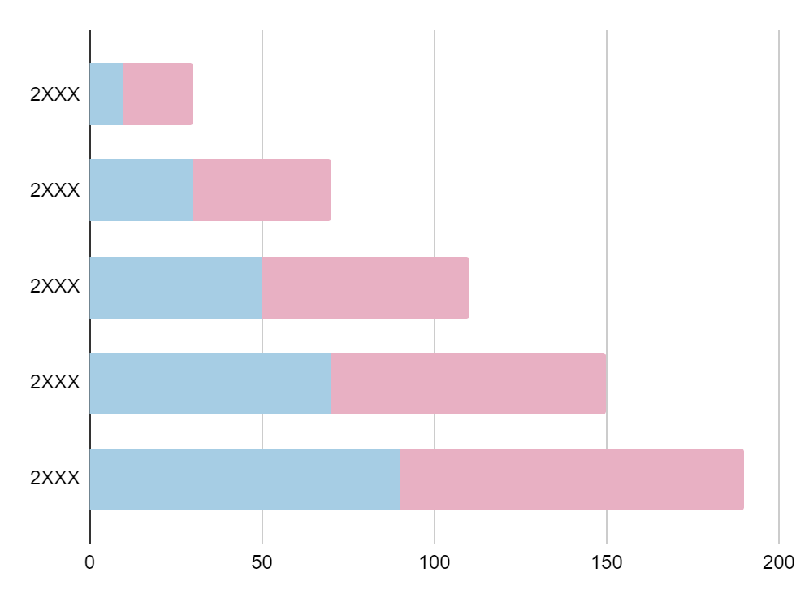
Bachelor's Degree in Microbiology
Mercury is very small and the closest planet to the Sun
Venus
Earth
Venus has a beautiful name
All humans live on this planet
Follow the link in the graph to modify its data and then paste the new one here. For more info, click here

Slide 19
Bachelor's Degree in Microbiology
Venus
Venus is the second planet from the Sun
Mercury
Earth
Jupiter
Mercury is the closest planet to the Sun and the smallest one in the entire Solar System
Earth is the only planet that harbors life
Jupiter is a gas giant and the biggest of them all. This planet was named after a Roman god
Mars
Despite being red, Mars is actually a cold place

Slide 20
Bachelor's Degree in Microbiology
TEST | GROUP A | GROUP B | GROUP C
Mercury is the closest planet to the Sun
Venus is the second planet from the Sun
Mars is a cold place. It’s full of iron dust
Jupiter is the biggest planet of them all
Saturn is a gas giant and has several rings
Neptune is the farthest planet from the Sun

Slide 21
Bachelor's Degree in Microbiology
Mercury
Neptune
It’s the closest planet to the Sun
It’s the smallest one in the Solar System
It was named after a Roman god
It’s very heavy, and why it rotates slowly
It’s the farthest planet from the Sun
It’s the fourth-largest planet by diameter
It’s very far away from the Sun
Neptune is a beautiful ice giant
25%
75%

Slide 22
Bachelor's Degree in Microbiology
Mars
Mars is actually a cold place
Mercury
Jupiter
Jupiter is a gas giant and it’s big
Sun
Venus
Saturn
Saturn has several beautiful rings
Neptune
Neptune is very far away from the Sun
Earth
Pluto
Pluto is considered a dwarf planet

Slide 23
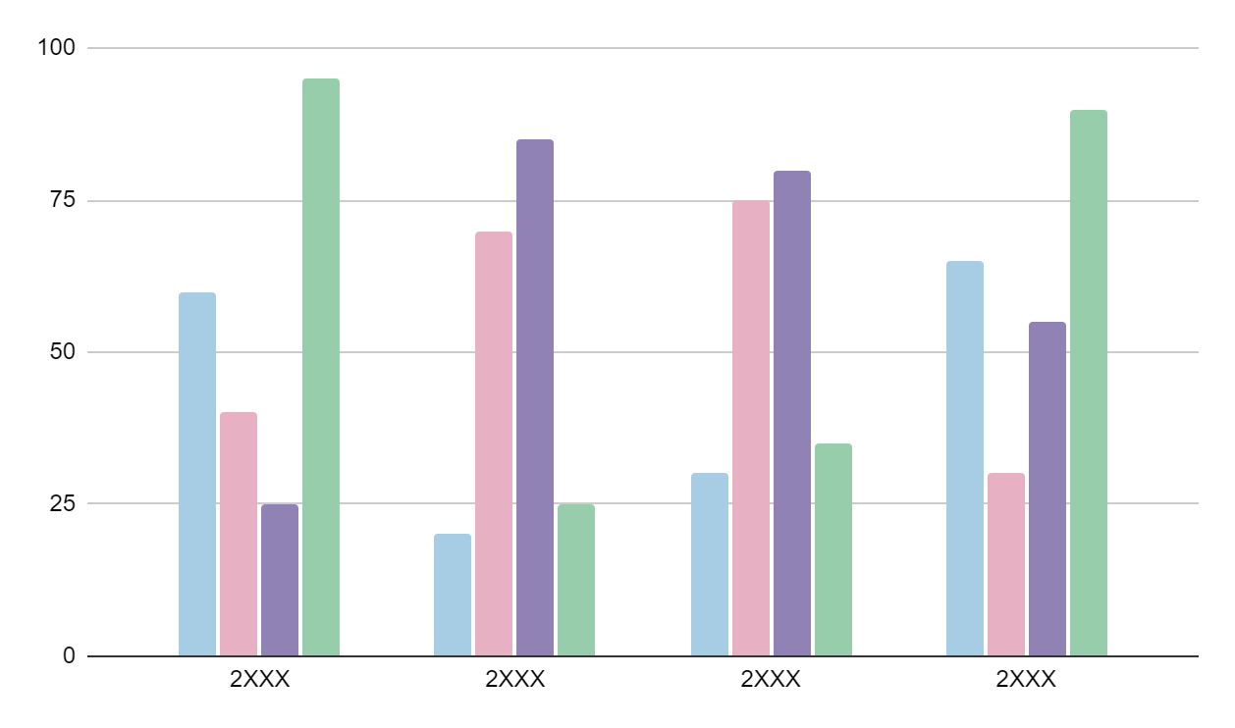
Bachelor's Degree in Microbiology
Mercury
Mercury is very small
Venus
Venus is terribly hot
Earth
Earth is the third planet
Mars
Mars is a very cold place
Follow the link in the graph to modify its data and then paste the new one here. For more info, click here

Slide 24
Bachelor's Degree in Microbiology
Mercury is the closest planet to the Sun and the smallest one
Saturn is composed mostly of hydrogen and helium
Venus has a beautiful name and is the second planet from the Sun
Neptune is the fourth-largest planet by diameter
Earth is the third planet and the only one that harbors life
The Sun is the star at the center of the Solar System
Despite being red, Mars is actually a cold place
Pluto is now considered a dwarf planet in the Solar System
Jupiter is giant and the biggest planet in the Solar System
Ceres is located in the main asteroid belt

Slide 25
Bachelor's Degree in Microbiology
EXPERIMENT 01 |  | EXPERIMENT 02 |  | EXPERIMENT 03
Mercury is small and the closest planet to the Sun Mercury was named after the Roman messenger god |  | Venus has a beautiful name is the second planet from the Sun It’s the second-brightest natural object in the night sky after the Moon |  | Despite being red, Mars is actually a very cold place It’s full of iron oxide dust, which gives the planet its reddish cast
RESULTS | It’s small | RESULTS | It’s very hot | RESULTS | Mars is red
 | It’s heavy |  | Venus is toxic |  | It’s very cold

Slide 26
Bachelor's Degree in Microbiology
5%
Mercury
Mercury is small and the closest planet to the Sun
10%
Venus
Venus is the second planet from the Sun
25%
Earth
Earth is the only planet that harbors life
50%
Mars
Despite being red, Mars is actually a cold place
75%
Jupiter
Jupiter is the biggest planet of them all

Slide 27
Bachelor's Degree in Microbiology
Experiment A
Experiment B
01
Mercury is the closest planet to the Sun and it’s very small
01
Jupiter is the biggest planet in the Solar System
02
Venus has a nice name and is the second planet from the Sun
02
Saturn is composed mostly of hydrogen and helium
03
Earth is the third planet and the only one that harbors life
03
Neptune is the fourth-largest planet by diameter
04
Despite being red, Mars is actually a cold place
04
Pluto is now considered a dwarf planet in the Solar System

Slide 28
Bachelor's Degree in Microbiology
 | Venus is the second planet from the Sun
 | The Earth is the only planet that harbors life
 | Mars is a cold place. It’s full of iron oxide dust
 | Jupiter is the biggest planet in the Solar System
 | Saturn is composed mostly of hydrogen and helium
 | Neptune is the farthest planet from the Sun
Experiment
Mercury is the closest planet to the Sun and the smallest of them all. Mercury was named after a Roman messenger god

Slide 29
Bachelor's Degree in Microbiology
Mercury
Venus
Earth
Mars
Mercury is the closest planet to the Sun
Venus is the second planet from the Sun
Earth is the only planet that harbors life
Mars is a cold place. It’s full of iron oxide dust
It was named after the Roman messenger god
Venus is very hot, even more than Mercury
Earth is the third one and know as the blue planet
Mars is red and was named after a Roman god

Slide 30
Bachelor's Degree in Microbiology
MONTH, 2XXX
MON | TUE | WED | THU | FRI | SAT | SUN
 |  |  |  | 1 | 2 | 3
4 | 5 | 6 | 7 | 8 | 9 | 10
11 | 12 | 13 | 14 | 15 | 16 | 17
18 | 19 | 20 | 21 | 22 | 23 | 24
25 | 26 | 27 | 28 | 29 | 30
Mercury
Mercury is the closest planet to the Sun
Venus
Venus is the second planet from the Sun

Slide 31
Bachelor's Degree in Microbiology
03
Earth
The Earth is the only planet that harbors life
02
Venus
Venus is the second planet from the Sun
01
Mercury
Mercury is small and the closest planet to the Sun

Slide 32
Bachelor's Degree in Microbiology
Mercury
Mercury is the closest planet to the Sun. It was named after the Roman messenger god
25%
Neptune
75%
Neptune is the farthest planet from the Sun. It’s also the fourth-largest planet by diameter

Slide 33
Bachelor's Degree in Microbiology
Sun
Mercury
Venus
Earth
It’s the star at the center of the Solar System
Mercury is small and the closest planet to the Sun
Venus is the second planet from the Sun
Earth is the only planet that harbors life
Neptune
Saturn
Jupiter
Mars
Neptune is the farthest planet from the Sun
Saturn is a gas giant and has several rings
Jupiter is the biggest planet in the Solar System
Despite being red, Mars is a cold place

Slide 34
Instructions for use
If you have a free account, in order to use this template, you must credit Slidesgo in your final presentation. Please refer to the next slide to read the instructions for premium users.
As a Free user, you are allowed to:
- Modify this template.
- Use it for both personal and commercial projects.
You are not allowed to:
- Sublicense, sell or rent any of Slidesgo Content (or a modified version of Slidesgo Content).
- Distribute Slidesgo Content unless it has been expressly authorized by Slidesgo.
- Include Slidesgo Content in an online or offline database or file.
- Offer Slidesgo templates (or modified versions of Slidesgo templates) for download.
- Acquire the copyright of Slidesgo Content.
For more information about editing slides, please read our FAQs or visit our blog:
https://slidesgo.com/faqs and https://slidesgo.com/slidesgo-school

Slide 35
Instructions for use (premium users)
As a Premium user, you can use this template without attributing Slidesgo.
You are allowed to:
Modify this template.
Use it for both personal and commercial purposes.
Share this template in an editable format with people who are not part of your team.
You are not allowed to:
Sublicense, sell or rent this Slidesgo Template (or a modified version of this Slidesgo Template).
Distribute this Slidesgo Template (or a modified version of this Slidesgo Template) or include it in a database or in any other product or service that offers downloadable images, icons or presentations that may be subject to distribution or resale.
Use any of the elements that are part of this Slidesgo Template in an isolated and separated way from this Template.
Register any of the elements that are part of this template as a trademark or logo, or register it as a work in an intellectual property registry or similar.
For more information about editing slides, please read our FAQs or visit our blog:
https://slidesgo.com/faqs and https://slidesgo.com/slidesgo-school

Slide 36
Infographics
You can add and edit some infographics to your presentation to present your data in a visual way.
Choose your favourite infographic and insert it in your presentation using Ctrl C + Ctrl V or Cmd C + Cmd V in Mac.
Select one of the parts and ungroup it by right-clicking and choosing “Ungroup”.
Change the color by clicking on the paint bucket.
Then resize the element by clicking and dragging one of the square-shaped points of its bounding box (the cursor should look like a double-headed arrow). Remember to hold Shift while dragging to keep the proportions.
Group the elements again by selecting them, right-clicking and choosing “Group”.
Repeat the steps above with the other parts and when you’re done editing, copy the end result and paste it into your presentation.
Remember to choose the “Keep source formatting” option so that it keeps the design. For more info, please visit our blog.

